Slide 1
Nuclear Chemistry
CHE 2105
Faculty of Applied Sciences
Rajarata University of Sri Lanka

Slide 2
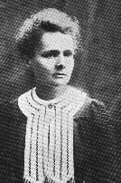
Radioactivity
One of the pieces of evidence for the fact that atoms are made of smaller particles came from the work of Marie Curie. (1876-1934).
She discovered radioactivity, the spontaneous disintegration of some elements into smaller pieces.

Slide 3
Radiochemistry is the study of the chemical properties of natural and artificial radio nuclides or the chemical phenomena associated with nuclear transformation.
Eg. N₂ gas interacts with the neutron component of cosmic radiation (comes from outer universe) resulting the nuclear reaction
¹⁴N + ¹n ¹⁴C + ¹H
7
0
6
1

Slide 4
When we look into the structure of the atoms;
We find that the atoms consist of a nucleus surrounded by electrons.
The nucleus contains two types of particles protons (positively charged) and neutrons (electrically neutral). Particles such as protons, neutrons and electrons are called elementary particles or fundamental particles.
A free neutron is unstable and decay.
However, a neutron in a nucleus is stable due to strong nuclear binding forces between the nucleons.

Slide 5
The nuclear binding forces are very strong and short range forces.
Which fall off very rapidly as the distance between the particles increases.
The particles which make up the nucleus are called collectively nucleons .

Slide 6
Nuclear Reactions vs. Normal Chemical Changes
1. Nuclear reactions involve the nucleus
2. The nucleus opens, and protons and neutrons are rearranged
3. The opening of the nucleus releases a tremendous amount of energy that holds the nucleus together – called binding energy

Slide 7
4. “Normal” Chemical Reactions involve electrons, not protons and neutrons

Slide 8
Forces in the Nucleus
Protons have a positive charge
In any nucleus containing two or more protons there will be electrostatic repulsion between the like charges.
In a stable nucleus, the attractive forces are greater than the repulsive forces.
In an unstable nucleus the repulsive forces exceed the attractive forces and spontaneous fission occurs.
Note : liquid drop model

Slide 9
Note: The attractive forces in the nucleus cannot be electrostatic for two reasons.
1. There are no oppositely charged particles.
2. the forces only act over a very short distance of 2-3 fm.
Note: If the nuclear particles are separated by a distance much greater than 2-3 fm, attraction ceases.

Slide 10

Mass Defect
Some of the mass can be converted into energy
Shown by a very famous equation!
E = mc²
Energy
Mass (or mass defects)
Speed of light

Slide 11
Here E, is known as binding energy.
Generally coated as energy changes in terms of the mega electron volt (MeV).
1 MeV = 9.6 x 10⁷ kJ mol⁻¹.

Slide 12
For eg.
The mass of the helium nucleus is 4.0017 amu, whereas the individual masses of the isolated proton and neutron are 1.0073 and 1.0087 respectively

Slide 13
The mass defect is; total mass – mass of the helium nucleus.
Total mass = (2 x 1.0073) + (2 x 1.0087)
= 4.0320 amu
Mass defect = (4.0320 – 4.0017 amu)
= 0.0303 amu

Slide 14
The loss in mass for the formation of 1 mole of helium atoms from isolated proton and neutrons is 0.0303 g.
E = mc² = (0.0303 x 10⁻³ kg) x (3 x 10⁸ m s⁻¹)²
= 2.727 x 10¹² J mol⁻¹
= 2.727 x 109 kJ mol⁻¹.

Slide 15
Therefore, the formation of one mole of helium nuclei from its isolated protons and neutrons result in the release of ;
(2.7 x 10⁹)/(9.6 x 10⁷ ) = 28 MeV.
Note: the helium nucleus contains four particles ( 2 protons and 2 neutrons), i.e 4 nucleons.
The binding energy per nucleon is 28 / 4 = 7 MeV.

Slide 16
Types of Radiation
Alpha (ά) – a positively charged helium isotope - we usually ignore the charge because it involves electrons, not protons and neutrons
Beta (β) – an electron
Gamma (γ) – pure energy; called a ray rather than a particle

Slide 17
Other Nuclear Particles
Neutron
Positron – a positive electron
Proton – usually referred to as hydrogen-1
Any other elemental isotope

Slide 18
Particles were discovered from cosmic rays and also from different nuclear reactions are;
Mesons
Neutrinos
Positron etc.,
Note: Each particle has its counterparts called antiparticles which differ in the sign of their charges but having identical masses.

Slide 19
Eg. electron (⁰₋₁e ) has its antiparticle called the positron (⁰₊₁e ).
Note: Antiparticles were also discovered from studies on cosmic rays and other nuclear phenomena.

Slide 20
Elementary particles (and antiparticles) can be classified into two broad categories according to their spins.
Fermions (with fractional spins, eg. electrons and protons) and
Bosons (with whole number spins eg. mesons and photons).

Slide 21
The fermions can be further divided into leptons (having masses < 283 m_{e}) and the baryons (those having masses > 283 m_{e}) where, m_{e} is mass of an electron)

Slide 22
Leptons
Higher particles
Eg. electrons, neutrinos

Slide 23
Mesons
Particles with intermediate mass-masses between that of electron and the proton

Slide 24
Baryons
Heavy particles
Nucleons , the protons and neutrons
Hyperons, particles of masses greater than that of neutrons.

Slide 25
Two nuclear particles may be held together by sharing a particle. (analogous to exchange forces result in a covalent bond between atoms).
The particle exchanged is called a π meson.
Mesons may have a positive charge π⁺ , a negative charge π⁻ or no charge πº . Exchange of π⁻ and π⁺ mesons accounts for the binding energy between neutrons and protons.
Note: The transfer of a charge converts a neutron to a proton or vice versa.

Slide 26
The resultant attractive forces are indicated by dotted lines below.
n
p
π-
p
n
p
n
π+
n
p

Slide 27
A πº meson is exchanged between two protons or two neutrons.
p
n
πº
p
p
n
n
πº
n
n
The attractive forces between p-n, n-n and p-p are probably all similar in strength.
All mesons are very unstable outside the nucleus.

Slide 28
The continual transfer of mesons means that the particles representing neutrons and protons are constantly changing.
The transformation of neutrons into protons and vice versa are first order reactions.
The rates of the reactions depend on the relative numbers of neutrons and protons present.
In a stable nucleus these two changes are in equilibrium.

Slide 29
Stability and the ratio of neutrons to protons
The stability of a nucleus depends on the number of protons and neutrons present.
For elements of low atomic number (up to Z=20), the most stable nuclei exist.

Slide 30
Elements with higher atomic numbers are more stable if they have a slight excess of neutrons as this increase the attractive force and also reduces repulsion between protons.
Thus the ratio N/P increases progressively up to about 1.6 (for eg. U).

Slide 31
N/P vs P
1.6
N/P
1.0
P
Note 1: In elements with higher atomic numbers, the nuclei have become so large they undergo spontaneous fission.
Note 2: Stable nuclei lie near to these curves.

Slide 32
Modes of Decay
Nuclei with N/P ratios appreciably higher or lower than the stable ratio are radioactive.
When they decay they form nuclei closer to the line of maximum stability.
If the N/P ratio is high, the isotope lies above the curve.
Such a nucleus will decay in such a way that it reduces the N/P ratio and form a stable arrangement.

Slide 33
The ratio can be reduced in the following ways.
Beta emission
Neutron emission
Positron emission
Orbital or K-electron capture
Proton emission
Gamma radiation
If the N/P ratio is too low, the isotope lies below the curve

Slide 34
Beta emission
Electrons or β radiation may be emitted from the nucleus when a neutron is converted into a proton, an electron and a neutrino.
This change reduces the N/P ratio.
The neutrino (ν) is a strange particle.
neutrino has zero mass and zero charge and is postulated to balance the spins.
Is emitted in almost all nuclear transformations.

Slide 35
The change of a neutron into a proton may be written:
¹n ¹p + ⁰e + ν
0
1
-1
The loss of an electron from the nucleus in this way decreases the N/P ratio
If an isotope is not far from the stable N/P line one β decay process may be sufficient.
¹⁴C ¹⁴N + ⁰e + ν
6
7
-1
Isotopes further from the stable line may undergo a series of β decays. The resultant nuclei become progressively more stable and have a longer half life period.

Slide 36
For eg.
¹⁴¹Ba ¹⁴¹La ¹⁴¹ Ce ¹⁴¹Pr
⁵⁶
^{18 min}
⁵⁷
^{3.7 h}
⁵⁸
²⁸ ^{days}
⁵⁹

Slide 37
Neutron emission
An obvious way to decrease the N/P ratio.
To emit a neutron from the nucleus.
This form of decay is rare and only takes place with highly energetic nuclei.
Because the binding energy of the neutron in the nucleus is high.
For eg.
⁸⁷Kr ⁸⁶Kr + ¹n
³⁶
³⁶
⁰
⁸⁷Rb ⁸⁷Sr
³⁷
³⁸

Slide 38
If the N/P ratio is too low, the isotope lies below the curve.
There are three possible modes of decay;
Positron emission
Orbital or K-electron capture
Proton emission

Slide 39
Positron emission
Positron or β+ radiation ( positive electron) result from the transformation of a proton to a neutron.
The positron is ejected from the nucleus together with an anti-neutrino ν
-
-
¹P ¹n + ⁰e + ν
1
0
1
The anti-neutrino is to balance the spins.
The mass of the parent nucleus is greater than the mass of the daughter nucleus.

Slide 40
This process increases the N/P ratio.
Some examples of positron emission are:
19
19
0
-
Ne F + e + ν
10
9
1
11
11
0
-
6
C B + e + ν
5
1

Slide 41
Orbital or K-electron capture
The nucleus may capture an orbital electron and thus convert a proton into a neutron with the emission of a neutrino.
P + e n + ν
1
-1
0
1
1
1
0
This process increases the N/P ratio. Usually an electron from the shell closest to the nucleus is captured
This is called the K shell, and the process is called K electron capture

Slide 42
Eg:
7
7
Be + e Li
0
4
-1
5

Slide 43
Proton emission
Except for nuclei in a very high energy state, proton emission is unlikely as the energy needed to remove a proton is about 8 MeV.

Slide 44
Gamma radiation
Immediately following any nuclear change, the neutrons and protons often have not arranged themselves in their most stable positions.
The newly formed daughter nucleus is thus in an excited state, and has a higher energy than the ground state.
Generally the nucleus rearrange themselves quite rapidly, thus lowering the energy of the daughter nucleus to the ground state.

Slide 45
The corresponding amount of energy is emitted, in the range of 0.1 – 1 MeV.
This is emitted as electromagnetic radiation of very short wavelength, called γ rays.

Slide 46
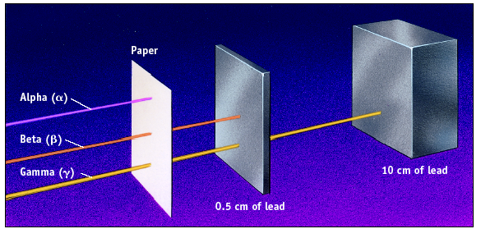
Penetrating Ability

Slide 47
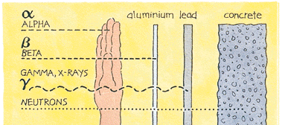
Penetrating Power of Different Types of Ionizing Radiation

Slide 48
Balancing Nuclear Reactions
In the reactants (starting materials – on the left side of an equation) and products (final products – on the right side of an equation)
Atomic numbers must balance
and
Mass numbers must balance
Use a particle or isotope to fill in the missing protons and neutrons

Slide 49
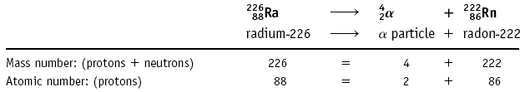
Nuclear Reactions
Alpha emission

Slide 50
Note that mass number (A) goes down by 4 and atomic number (Z) goes down by 2.
Nucleons (nuclear particles… protons and neutrons) are rearranged but conserved

Slide 51
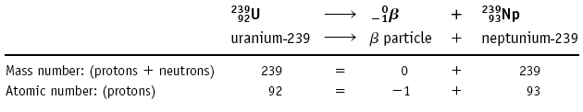
Nuclear Reactions
Beta emission

Slide 52
Note that mass number (A) is unchanged and atomic number (Z) goes up by 1.

Slide 53
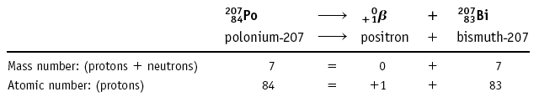
Other Types of Nuclear Reactions
Positron (⁰₊₁β): a positive electron
207
207

Slide 54
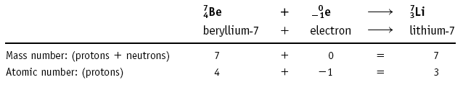
Electron capture: the capture of an electron

Slide 55
What radioactive isotope is produced in the following bombardment of boron?
¹⁰B + ⁴He ? + ¹n
⁵
²
⁰
¹³
¹³
^{X}
→
^{N}
⁷
⁷

Slide 56
Write Nuclear Equations!
Write the nuclear equation for the beta emitter Co-60.

Slide 57
Units of radioactivity
Name | Symbol | defined to be
Curie | Ci | 3.7 x 10¹⁰ disintegration per second
Bacquerel | Bq | One disintegration per second
Gray | Gy | 1 kg of tissue receiving 1 J of energy
Sievert | Sv | Gray x quality number of radiation (e.g 20 for α, 1 for β

Slide 58
Artificial Nuclear Reactions
New elements or new isotopes of known elements are produced by bombarding an atom with a subatomic particle such as a proton or neutron -- or even a much heavier particle such as ⁴He and ¹¹B.
Reactions using neutrons are called γ reactions because a γ ray is usually emitted.
Radioisotopes used in medicine are often made by γ reactions.

Slide 59
Artificial Nuclear Reactions
Example of a γ reaction is production of radioactive ³¹P for use in studies of P uptake in the body.
³¹₁₅P + ¹₀n → ³²₁₅P + γ

Slide 60
Transuranium Elements
Elements beyond 92 (transuranium) made starting with an γ reaction
²³⁸₉₂U + ¹₀n ---> ²³⁹₉₂U + γ
²³⁹₉₂U ---> ²³⁹₉₃Np + ⁰₋₁β
²³⁹₉₃Np ---> ²³⁹₉₄Pu + ⁰₋₁β

Slide 61
Radioactive Series
Naturally occurring radioactive nuclides have masses ranging from A=3 (tritium) to A= 238 (uranium)
The heavy elements fall into three radioactive families or series beginning with;
²³²Th (Thorium Series)
²⁴¹Pu(Neptunium Series)
²³⁸U and (Uranium Series)
²³⁵U (Actinium Series)
In each series, successive α and β emissions finally transform these to stable isotopes of Pb with masses 206, 207 and 208.

Slide 62
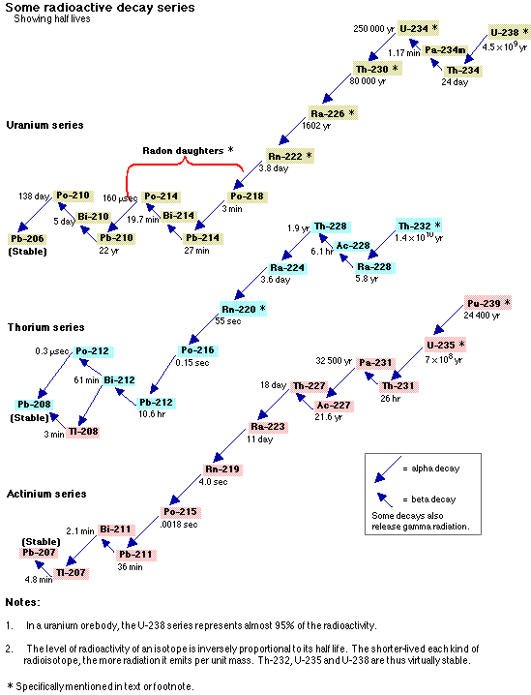
Natural Decay Chains

Slide 63
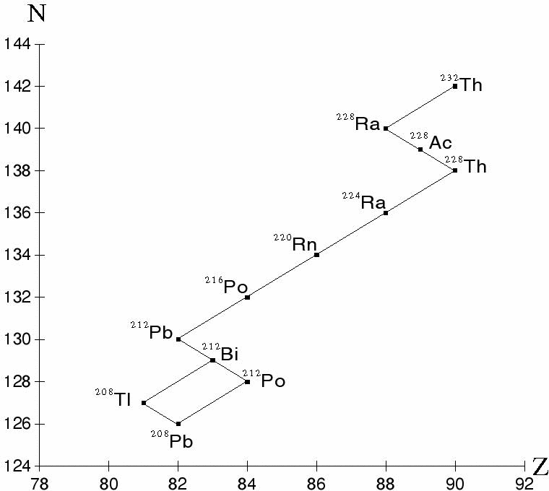
Thorium Decay Chain (4n + 0)
1.4 x 10¹⁰ y

Slide 64
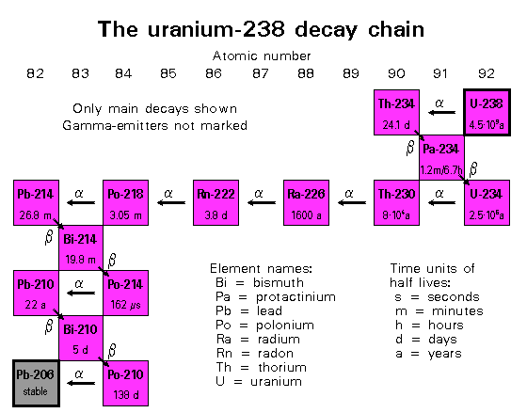
(4n + 2)
4.5 x 10⁹ y

Slide 65
The Actinium Decay Series (4n +3)
²³⁵U → …→ ²⁰⁷Pb (7 alphas and 4 betas)
7.04 x 10⁸ y

Slide 66
An Extinct Natural Decay Chain
Neptunium decay series (4n + 1)
²³⁷Np (t_{1/2} = 2.14 x 10⁹ y ) →…→²⁰⁹Bi

Slide 67
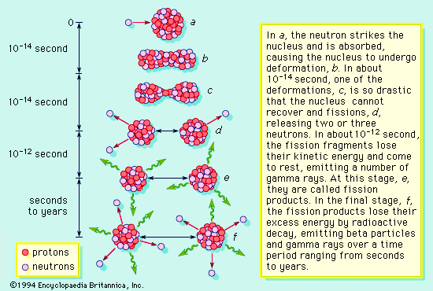

Slide 68
Radioactive Decay Processes
These radioactive products are the waste products of nuclear reactors.

Slide 69
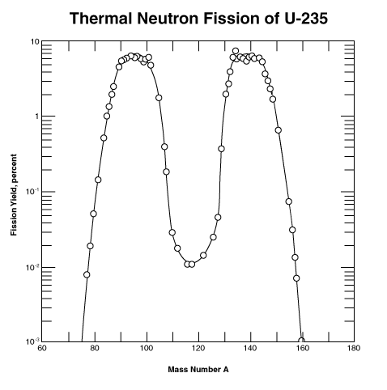
Mass Distribution of Fission
The fragments in the vicinity of A = 95 and A = 140 share 92 protons.
Prompt neutrons are emitted in 10⁻¹⁶ s.
Delayed neutrons intensity 1 in 100 fissions or 0.02 neutrons per fission
(from neutron emission).
Delayed neutrons are essential for controlling the reactors.
95
140
symmetric
Source: University of Waterloo

Slide 70
²³²Th (Thorium Series)
Known as 4n series
All members will have masses which are multiples of 4

Slide 71
²³²Th (1.39x10¹⁰ y)
²²⁰Rn (54.5 s)
^{α}
^{α}
²²⁸Ra ^{(6.7 y)}
²¹⁶Po (0.158 s)
^{β}
^{α}
^{α}
²²⁸Ac (6.13 hrs)
²¹²Po (3 x 10⁻⁷ s)
²¹²Po
^{β}
^{β}
^{β}
^{228Th} (1.90 y)
²⁰⁸Pb (stable)
^{β}
²¹²Bi (60.6 mon)
^{α}
^{α}
²²⁴Th (3.64 d)
²⁰⁸Tl (3.1 mon)

Slide 72
^{Neptunium series}
4n + 1 series.
This series known a Np (neptunium) series, since Np is the longest lived member.
Only trace quantities of this isotopes are found in nature and its origins are quit different from those of the other series.

Slide 73
Non of its member have sufficiently long half lives .
(4n+1) series ends with a bismuth (Bi) isotope and also it contains no isotope of radon.

Slide 74
4n + 1) series
^{β}
²⁴¹Pu
²⁴¹Am
^{α}
^{α}
^{α}
^{β}
^{α}
^{β}
^{α}
²³⁷Np
²³³Pa
²³³U
²²⁹Th
²²⁵Ra
²²⁵Ac
²²¹Fr
²³⁷U
^{β}
^{α}
^{α}
²¹³Bi
²¹⁷At
^{β}
^{α}
²¹³Po
²⁰⁹Tl
^{α}
^{β}
²⁰⁹Pb
^{β}
²⁰⁹Bi

Slide 75
²³⁸U (Uranium Series)
(4n + 2) series

Slide 76
²³⁸U (4.51 x 10⁹ y)
²²⁶Ra (1622 y)
^{α}
^{α}
²³⁴Th ^{(24.1 d)}
²²²Rn (3.825 d)
^{β}
^{α}
^{α}
^{β}
²³⁴Pa (1.18 mon)
²¹⁸At (1.3 s)
²¹⁸Po (3.05 mo)
^{β}
^{α}
^{β}
²¹⁴Po (1.6 x 10⁻⁴ s)
^{α}
^{β}
²³⁴U
²¹⁴Bi (19.7 mon)
^{α}
²¹⁴Pb (26.8mon)
^{α}
^{α}
^{β}
²¹⁰Pb (22 y)
²³⁰Th (7.52 x 10⁴) y
²¹⁰Tl (1.32 mon)
^{α}
^{α}
²¹⁰Bi (5.01 d)
²⁰⁶Hg (8.5 mon)
^{α}
²¹⁰Po (138.4 d)
²⁰⁶Tl (4.3 mon)
^{α}
^{β}
²⁰⁶Pb(stable)

Slide 77
The Actinium Series
(4n + 3) series

Slide 78
²¹⁹At (0.9 mo)
^{α}
²¹⁹Rn (3.9 s)
²³⁵U
^{α}
²¹⁵Bi (8 mon)
^{β}
^{α}
^{β}
²¹⁵At (10⁻⁴ s)
^{α}
²¹²Po (3 x 10⁻⁷ s)
^{α}
²³¹Ra ^{(25.6 h)}
^{β}
^{α}
^{β}
²¹¹Bi (2.15 mo)
²³¹Pa (3.48 x 10⁴ y)
²¹¹Pb (36.1 mo)
^{β}
²²⁷Th (18.17 d)
^{α}
^{β}
^{α}
^{α}
^{α}
²²⁷Ac (22.0 y)
²²³Ra (11.7 d)
²⁰⁷Tl (4.79 mo)
²¹²Po (0.52 s)
^{α}
^{β}
^{β}
^{α}
²²³Fr (22 mo)
²⁰⁷Pb (stable)

Slide 79
Nuclear Chemistry
Fission & Fusion

Slide 80
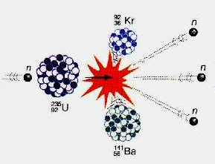
A. F ission
splitting a nucleus into two or more smaller nuclei
1 g of ²³⁵U = 3 tons of coal

Slide 81
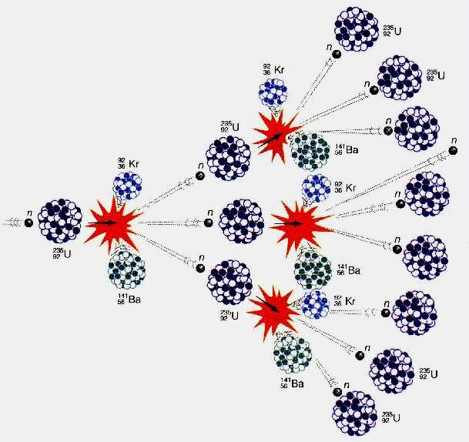
A. F ission
chain reaction - self-propagating reaction
critical mass - mass required to sustain a chain reaction

Slide 82
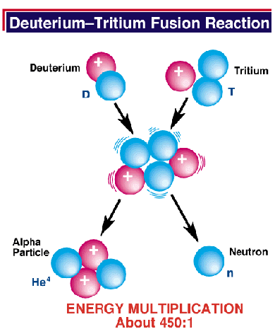
B. Fusion
combining of two nuclei to form one nucleus of larger mass
thermonuclear reaction – requires temp of 40,000,000 K to sustain
1 g of fusion fuel = 20 tons of coal
occurs naturally in stars

Slide 83
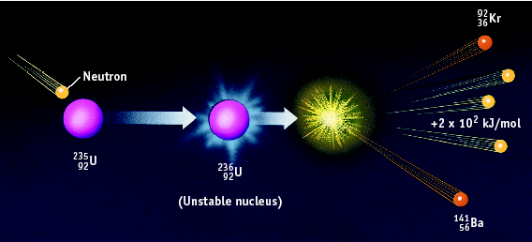
Nuclear Fission

Slide 84
Nuclear Fission
Fission is the splitting of atoms
These are usually very large, so that they are not as stable
Fission chain has three general steps:
1. Initiation. Reaction of a single atom starts the chain (e.g., ²³⁵U + neutron)
2. Propagation. ²³⁶U fission releases neutrons that initiate other fissions
3. ___________ .

Slide 85
Involves the splitting of the nucleus into two nuclei of roughly equal mass.
For example U
235
92
U
235
Undergo a spontaneous fission
92
Here neutrons may be absorbed by U
Initially neutrons originates from the spontaneous fission of uranium or from cosmic rays.

Slide 86
235
1
139
95
1
U
+
n
Xe
+
Kr
+
2
n
92
0
54
38
0
235
1
139
95
1
U
+
n
Ba
+
x
+
2
n
92
0
56
36
0
235
1
139
94
1
Ba
+
x
+
n
+
energy
U
+
n
3
92
0
56
36
0
More fission
+
neutrons
+
energy
neutrons
More fission

Slide 87
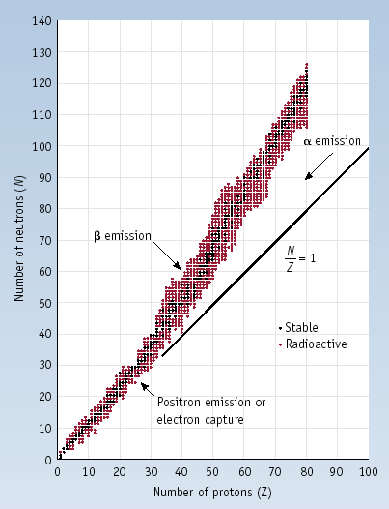
Stability of Nuclei
Out of > 300 stable isotopes:
N
Even
Odd
Z
Even
157
52
³¹₁₅P
Odd
50
5
¹⁹₉F
²₁H, ⁶₃Li, ¹⁰₅B, ¹⁴₇N, ¹⁸⁰₇₃Ta

Slide 88
Band of Stability and Radioactive Decay

Slide 89
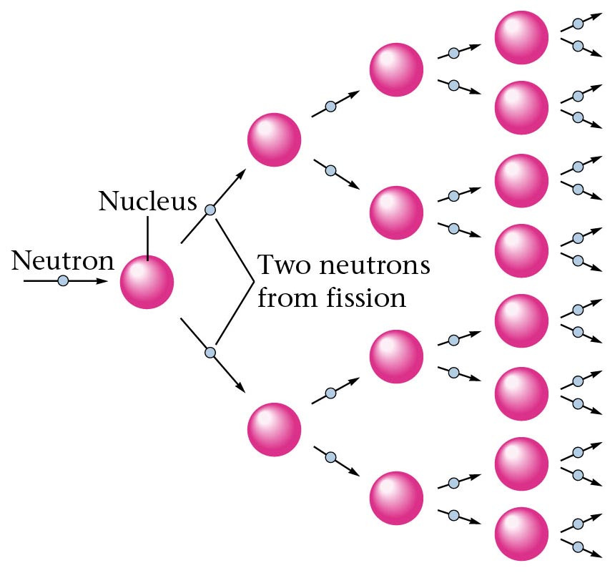
Representation of a fission process.

Slide 90
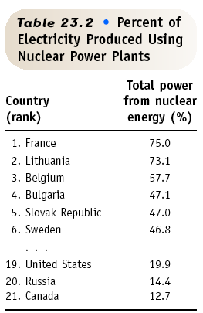
Nuclear Fission & POWER
Currently about 103 nuclear power plants in the U.S. and about 435 worldwide.
17% of the world’s energy comes from nuclear.

Slide 91
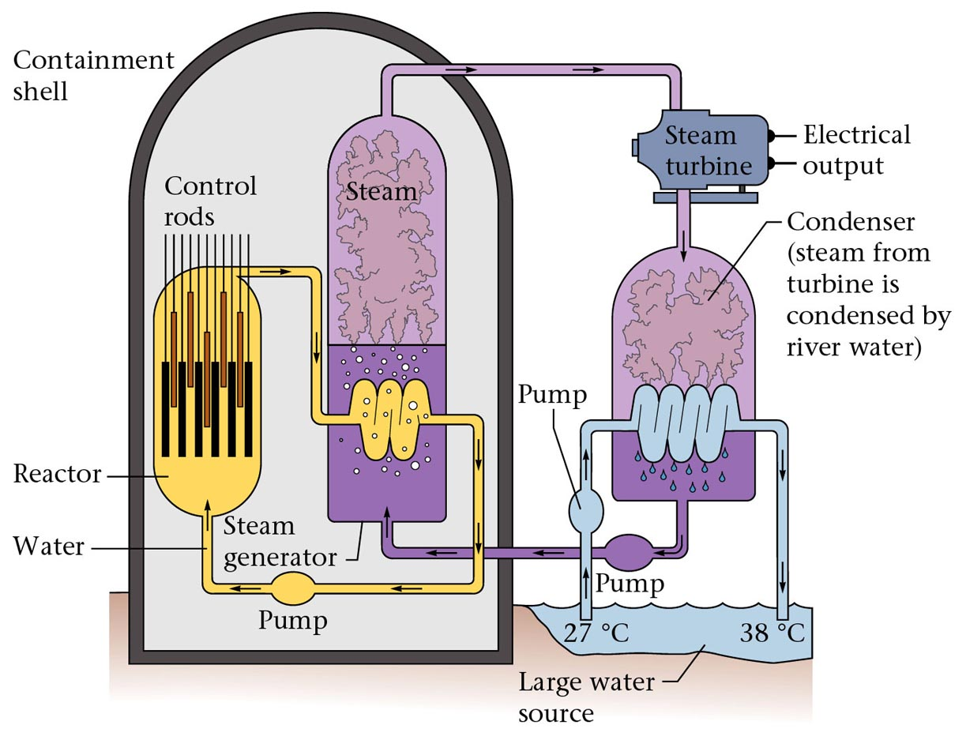
Figure 19.6: Diagram of a nuclear power plant.

Slide 92
Nuclear Fusion
Fusion
small nuclei combine
²H + ³H ⁴He + ¹n +
1 1 2 0
Occurs in the sun and other stars
Energy

Slide 93
Nuclear Fusion
Fusion
Excessive heat can not be contained
Attempts at “cold” fusion have FAILED.
“Hot” fusion is difficult to contain

Slide 94
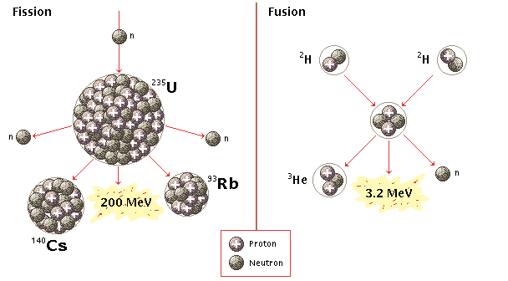
C. Fission vs. Fusion
FISSION
FUSION
²³⁵U is limited
danger of meltdown
toxic waste
thermal pollution
fuel is abundant
no danger of meltdown
no toxic waste
not yet sustainable

Slide 95
Half-Life
HALF-LIFE is the time that it takes for 1/2 a sample to decompose.
The rate of a nuclear transformation depends only on the “reactant” concentration.

Slide 96
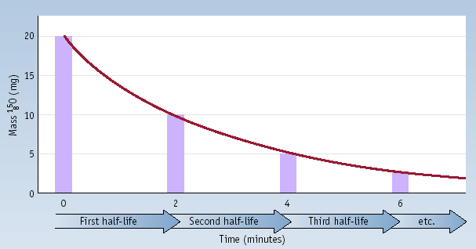
Half-Life
Decay of 20.0 mg of ¹⁵O. What remains after 3 half-lives? After 5 half-lives?

Slide 97
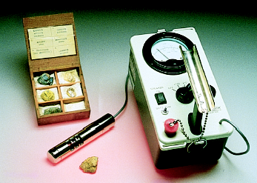
Kinetics of Radioactive Decay
For each duration (half-life), one half of the substance decomposes.
For example: Ra-234 has a half-life of 3.6 days If you start with 50 grams of Ra-234
After 3.6 days > 25 grams
After 7.2 days > 12.5 grams
After 10.8 days > 6.25 grams

Slide 98
The half life of ¹²³I is 13 hr. How much of a 64 mg sample of ¹²³I is left after 39 hours?

Slide 99
Radioactive Decay Law
Radioactive transformation occurs due to instability of a nucleus that results from an unbalanced neutron.
Usually α and β particles emitted in the process.
An excited nucleus also tends to stabilize itself by decay to its ground state where the excess energy is emitted in the form of gamma (γ) rays.

Slide 100
This decay or disintegration is a random process and its behaviour is described by the radioactive law.

Slide 101
A_{t} = A_{o} e^{-λt}
Where
A_{o}= radioactivity present initially in a sample.
A_{t} = radioactivity after time t
λ = disintegration constant or decay constant and is the
fraction of decay / unit time.
The value of λ is characteristic of a given radioactive decay process.

Slide 102
Activity is proportional to number of atoms (N)
N_{t} = N_{o}e^{-λt}
Where
N_{o}= number of atoms initially.
N_{t} = number of atoms at time t

Slide 103
The rate of decay
The decay of a radioactive element is a random process
Not influenced by external factors such as temperature changes.
The rate of decay is directly proportional to the number of atoms present.

Slide 104
The rate of decay decreasing with time.
Kinetically the process is a first order reaction and can be expressed by the equation:-

Slide 105
Rearrangement of equation followed by integration gives:
-ln N = λ t + const.
If the number of radioactive atoms present at time t = 0 is N₀, then
-ln N₀ = const.
-ln N = λ t - ln N0
or
ln (N₀/N) = λ t

Slide 106
2.303 log (N₀/N) = λt
Let t_{½} represent the time needed for the original activity to decrease a half, i.e N₀ = 2N , then
2.303 log (N₀/½N₀) = 2.303 log 2 = λt_{½}
0.693 = λt_{½}
t_{½} = 0.693/ λ

Slide 107
Radioactive Equilibrium Law
Consider a parent α emitter of very long half life decaying to a daughter β emitter of very short half life.
Initially, the parent fraction will continue its α activity but will for the moment be free of β radiation associated with the daughter.
However, in time new daughters will be formed and the daughter activity in the parent fraction will return to its initial value, with a time scale corresponding to the rate of decay of the isolated daughter fraction.

Slide 108
In an undisturbed sample containing N₁ atoms of the parent a steady state will be reached in which the rate of formation of formation of daughters N₂ is just equal to their rate of decay.
i.e. the rate of formation of the daughter atoms is just the rate of decay of the parent atoms.
Therefore, -dN₁/dt = λ₂N₂
Then, λ₁N₁ = λ₂N₂ is known as the radioactive Equilibrium law.

Slide 109
No account is taken for decrease of N₁ with time as the fraction of parent atoms transformed is negligible.
i.e for successive decays, λ₁<<< λ₂ << λ₃ etc.
Note: The radioactive equilibrium law applies whenever a short lived daughter is formed from the decay of a very long lived parent.

Slide 110
Effects of Radiation
Effect of a single dose of radiation.
Dose (rem) | effect
0 – 25 26 – 50 51 – 100 101 –200 201 –500 > 500 | No effect observed Small decrease in white blood cell count Significant decrease in white blood cell count, lesions Loss of hair, nausea Hemorrhaging, ulcers, death in 50 % of population death

Slide 111
Detection of Radiation
The detection of radiation associated with radioactivity depends on the detection of charged particles.
The types of detectors are:
1. The cloud chamber.
2. The bubble chamber.
3. The Geiger Muller tube / counter.
4. Photographic emulsion.

Slide 112
1. The cloud chamber.
The device consists of a chamber into which is introduced dust-free air saturated with water vapour.
Camera
Glass top
Radioactive source
light
Dark screen
piston
Chamber

Slide 113
Rapid expansion of the damp air, obtained by movement of the piston, causes a drop in temperature, and the air becomes supersaturated with the water vapour.
Any ions that happen to pass through the chamber act as nuclei onto which tiny droplets of water condense.
The trucks of these ions become visible and may be photographed.

Slide 114
The chamber contains a supersaturated vapor (e.g. methylated spirits), which condenses into droplets when disturbed and ionized by the passage of a particle.
There are two types of cloud chambers:
the "expansion" type & the "diffusion" type.

Slide 115
2. The bubble chamber.
The apparatus involves the boiling of a liquid under pressure and then the sudden release of pressure in order to obtain a superheated liquid. i.e the absence of the usual gaseous phase.
When ions pass through this superheated liquid they act as nuclei on which bubbles form and rapidly grow in size.
The tracks of any ions are made visible and are photographed.

Slide 116
Note: The bubble chamber is superior to the cloud chamber since the tracks are much denser.
Liquid hydrogen has been used in such chambers as the working fluid.

Slide 117
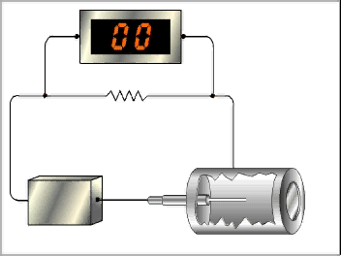
Geiger Counter
Used to detect radioactive substances
Thin mica window
Wire anode
To counter
Condenser
radiation
resistor
400 V
cathode

Slide 118
GM tube consists of a metallized glass tube cathode sealed at one end by a thin mica window.
Anode is a tungsten wire.
The tube may be filled with a variety of gases at low pressure.
Gases are argon bromine vapour (mixture)
A potential difference of about 400 v is applied across the anode and cathode.
The absence of ionizing radiation the tube is a nonconductor of electricity.

Slide 119
When an ionising particle enters the tube, the gas inside is ionised to give positive ions and electrons.
Electrons travel to their respective electrodes. --> current flows.
This current produces a potential differences across the resistor, which is then amplified and recorded.
Modern GM tubes are capable of recording up to 10⁵ counts per second.

Slide 120
4. Photographic emulsion
Ionizing radiation causes the blackening of photographic film.
In view of the rather high density of photographic emulsion the tracks produced by ionizing radiation are very short range.
Views under high magnification.

Slide 121
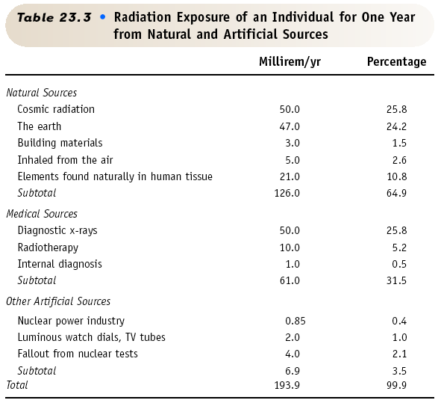

Slide 122
Nuclear Chemistry
Applications

Slide 123
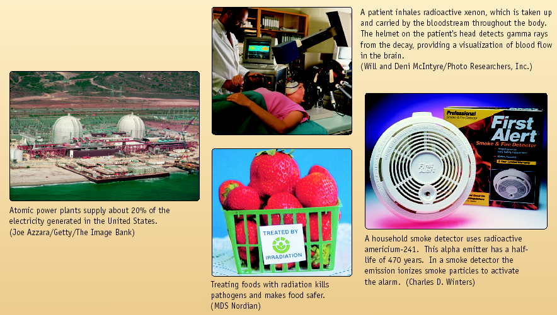
Nuclear Chemistry

Slide 124
Radiocarbon Dating
Radioactive C-14 is formed in the upper atmosphere by nuclear reactions initiated by neutrons in cosmic radiation
¹⁴₇N + ¹_{o}n ---> ¹⁴₆C + ¹₁H
The C-14 is oxidized to CO₂, which circulates through the biosphere.
When a plant dies, the C-14 is not replenished.
But the C-14 continues to decay with t_{1/2} = 5730 years.
Activity of a sample can be used to date the sample.

Slide 125
¹²₆C from ¹²₆CO₂
¹⁴₆C from ¹⁴₆CO₂
Ratio of ¹²₆C to ¹⁴₆C is 2 to 1 and is kept constant
Living material
dies
Ratio of ¹²₆C to ¹⁴₆C is 4 to 1 and gradually changes
Dead material

Slide 126
The proportions of ¹⁴₆C in the dead material starts to decrease.
This is because if the decay of the ¹⁴₆C.
¹⁴₆C → ¹⁴₇N + ⁰₋₁e
As a result we can use the proportion of ¹⁴₆C as a measure of the age of the sample.
Note: the accuracy of carbon dating is upset by several factors.

Slide 127
Cosmic ray activity is not constant and is known to vary considerably over a periods.
When fossil fuels such as coal and oil are burnt in large quantities the ¹⁴C they contain is liberated into the atmosphere.
The nuclear bomb tests release a great deal of radiation into the atmosphere. This increase of ¹⁴C in the atmosphere.

Slide 128
Geological dating
Radioisotopes have been used to date rocks.
Decay of ₄₀K to ₄₀Ar by electron capture.
Any rocks containing K compounds will accumulate Ar by the above process.

Slide 129
Industrial uses
The incorporation of a radioisotope of a meta into the piston rings of engines allows the accurate measurements of wear by friction.
The engine is run under test for a specified period and the amount of radioactivity in the lubricating oil determined.
This tests have been useful in the development of more efficient engine oils.

Slide 130
β-particle emitters can be used to measure the thickness of metal plate.
The amount of radioactivity penetrating the metal being measured with a suitable detector which is calibrated in units of length.

Slide 131
Detection of metal fatigue
There were many aircraft accidents were reported due to fatigue in metal surrounding the windows.
Checks for metal fatigue are now made regularly on air craft.
One way in which this is done is to use gamma rays from 60Co.
Where fatigue sets in the structure of the metal crystals changes.

Slide 132
γ-rays do not pass equally well through both the good and bad areas.
If the γ-rays fall on a photographic film after passing through the metal, any differences in structure show up.
A similar technique can make use of neutrons rather than γ-rays.
Note: tests for fatigue are essential in checking nuclear power stations.

Slide 133
Medical uses of radioactivity
The first use of radioactivity in medicine was the use of radium in the treatment of cancers.
Radiation is focused on the growth or tumour, and the energy that the particles carry is used to disrupt the malignant cells.
For example: sources for fast neutrons have been found to be very successful in treating cancers of the throat.

Slide 134
However, it is vital that the radiation treatment is carried out with care.
Healthy tissue is just a liable to damage as that of the growth.

Slide 135
Cobolt-60 , which is a γ-ray emitter has been used in carefully controlled situations to arrest the growth of cancerous cells.
Abnormal circulation of the blood can be investigated by injecting the patient with a solution of NaCl, containing radioactive ₂₄Na.
The radioactivity in the bloodstream can then be traced using a Geiger-Muller counter.

Slide 136
Use isotopes as a way of studying the chemical reactions that take place in the body.
For example: iodine is an essential element for health.
Normally it collects in the thyroid gland in the neck.
A person suffering from a deficiency of iodine is liable to suffer from a huge growth in the neck.

Slide 137
By feeding patient with radioactive iodine ₁₃₁I, it is possible to discover where the iodine collects in the body, or if it is not absorbed at all.
The presence of ₁₃₁I in the thyroid gland can be detected by a Geiger counter.

Slide 138
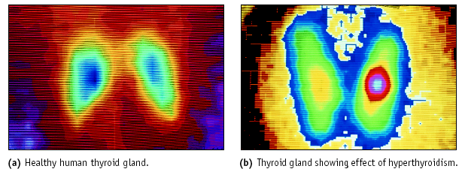
Nuclear Medicine: Imaging
Thyroid imaging using Tc-99m

Slide 139
Food preservations
γ-rays are especially good at passing through matter and very energetic.
These properties of γ-rays have been used in food preservations.
If foodstuffs are irradiated by a beam of γ-rays, bacteria that may be present are killed.
Note: however, there has been many concern about use of γ-rays .
Many people are worried in case the foodstuff itself is changed by the γ-rays and that may be dangerous to eat.

Slide 140
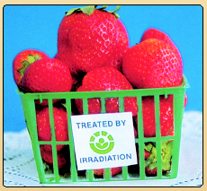
Food Irradiation
Food can be irradiated with γ rays from ⁶⁰Co or ¹³⁷Cs.
Irradiated milk has a shelf life of 3 mo. without refrigeration.
USDA has approved irradiation of meats and eggs.

Slide 141

The Nucleus
The atomic nucleus consists of protons and neutrons
Protons and neutrons are generally called nucleons
A nucleus is characterized by:
A: Mass Number = number of nucleons
Z: Charge Number = number of protons
N: Neutron Number
Determines the Element
Determines the Isotope
Of course A=Z+N
Usual notation:
Mass number A
¹²C
Element symbol – defined by charge number C is Carbon and Z = 6
So this nucleus is made of 6 protons and 6 neutrons

Slide 142
Mass
Nuclear and atomic masses often given in
u: atomic mass unit
12.000 u = 12 daltons mass of a neutral ¹²C atom
1 u = 1.6605 x 10⁻²⁷ kg
Mass and energy are interchangeable –
E = mc²
where energy usually expressed in MeV
1 MeV = 1.602 x 10⁻¹³ J
1 u = 931.5 MeV/c²

Slide 143
Isotopes: same Z ⁴⁰Ca, ⁴²Ca, ⁴⁴Ca
often, ‘isotope’ used instead of ‘nuclide’
isotopes have same Z, so same number of electrons => same chemistry
use radioactive isotope in place of stable one – can monitor
decay for tracer studies
Isotones: same N ⁴⁰Ca, ⁴²Ti, ⁴⁴Cr
Isobars: same A ⁴²Ca, ⁴²Ti, ⁴²Cr
Isodiaphors: same neutron excess ⁴²Ca, ⁴⁶Ti, ⁵⁰Cr
isodiaphors
Z
isotopes
isobars
isotones

Slide 144
Classification of Nuclides
Stable nuclei: 264; ¹⁶O
Primary natural radionuclides: 26; very long half-lives; ²³⁸U with t_{1/2} = 4.47 x 10⁹ y
Secondary natural radionuclides: 38; ²²⁶Ra t_{1/2} = 1600 y decay of ²³⁸U
Induced natural radionuclides: 10; cosmic rays; ³H t_{1/2} = 12.3 y; ¹⁴N(n,t)¹²C
Artificial radionuclides: 2-4000, ⁶⁰Co, ¹³⁷Cs…

Slide 145
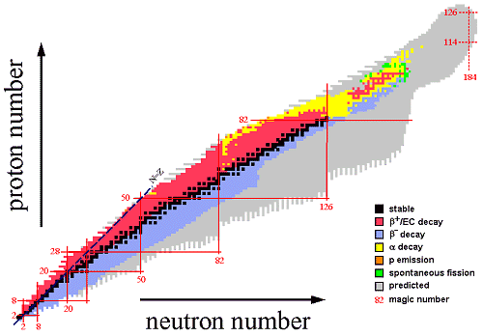
Chart of Nuclei
plot of nuclei as a function of Z and N
“Not just one box per element”

Slide 146
…or Segre Chart
plot allows various nuclear properties to be understood at a glance, similar
to how chemical properties are understood from the periodic chart
~ 2500 different nuclei known
270 stable/non-radioactive
theorists guess at least 4000 more to be discovered at higher neutron numbers, higher mass
limits –
proton-rich side (left of stable): proton dripline cannot add another proton, it “drips” off dripline is known/accessible to experiments
neutron-rich side (right of stable): neutron dripline cannot add another neutron, it “drips” off dripline is unknown – neutron-rich nuclei difficult to produce/study
mass (above stable) – cannot add another proton or neutron limit unknown – again, difficult to produce/study
“island of stability” predicted near Z = 114; not yet observed

Slide 147
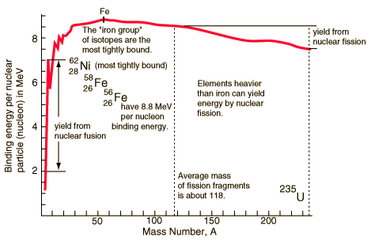
Binding energy per nucleon
http://hyperphysics.phy-astr.gsu.edu/

Slide 148
Fusion Reaction

Slide 149
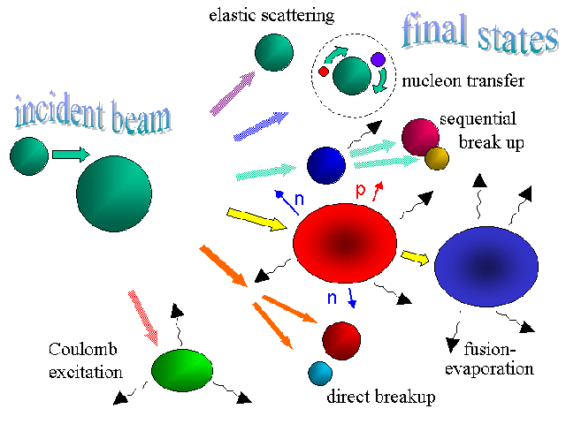
How Do We Produce Exotic Nuclei?

Slide 150
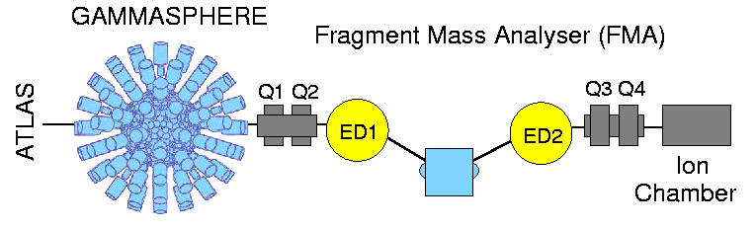
⁵⁸Zn₂₈
³⁶Ar + ²⁴Mg → ⁶⁰Zn*→ ⁵⁸Zn + 2n
σ(2n) < 20 μb (20 x 10⁻³⁴ m²)
Spokespersons: C. Andreoiu and P.E. Garrett, University of Guelph
@ Argonne National Laboratory, Chicago, 2006

Slide 151
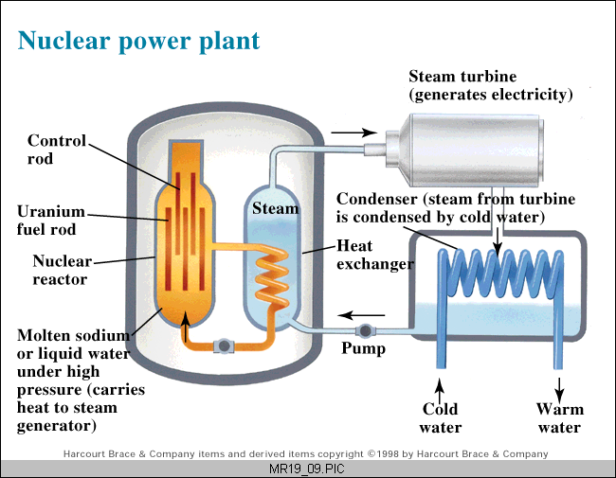
A. Nuclear Power
Fission Reactors
Cooling Tower

Slide 152
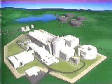
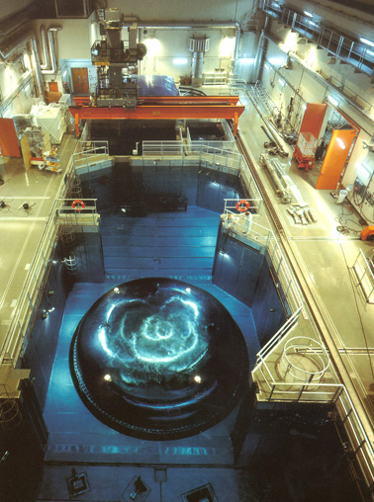
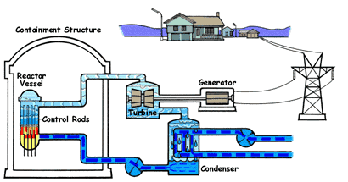
A. Nuclear Power
Fission Reactors

Slide 153
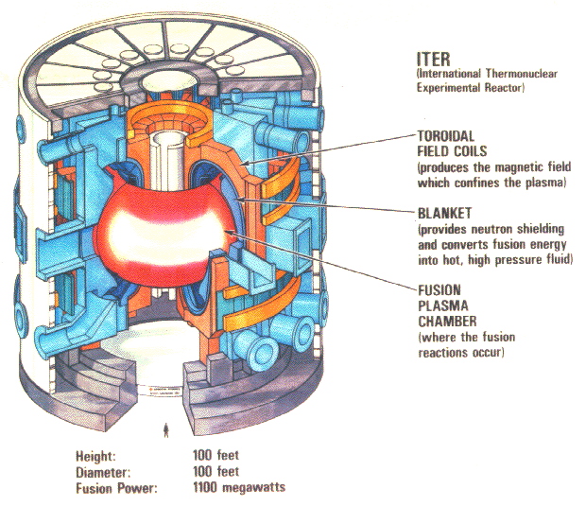
A. Nuclear Power
Fusion Reactors (not yet sustainable)

Slide 154
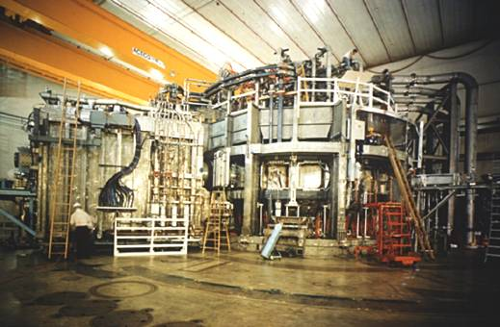
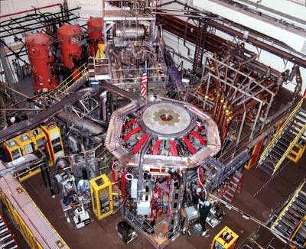
A. Nuclear Power
Fusion Reactors (not yet sustainable)
National Spherical Torus Experiment
Tokamak Fusion Test Reactor

Slide 155
B. Synthetic Elements
Transuranium Elements
elements with atomic #s above 92
synthetically produced in nuclear reactors and accelerators
most decay very rapidly

Slide 156
C. Radioactive Dating
half-life measurements of radioactive elements are used to determine the age of an object
decay rate indicates amount of radioactive material
EX: ¹⁴C - up to 40,000 years ²³⁸U and ⁴⁰K - over 300,000 years

Slide 157
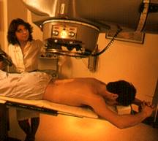
D. Nuclear Medicine
Radioisotope Tracers
absorbed by specific organs and used to diagnose diseases
Radiation Treatment
larger doses are used to kill cancerous cells in targeted organs
internal or external radiation source
Radiation treatment using
γ-rays from cobalt-60.

Slide 158
E. Nuclear Weapons
Atomic Bomb
chemical explosion is used to form a critical mass of ²³⁵U or ²³⁹Pu
fission develops into an uncontrolled chain reaction
Hydrogen Bomb
chemical explosion → fission → fusion
fusion increases the fission rate
more powerful than the atomic bomb

Slide 159
F. Others
Food Irradiation
γ radiation is used to kill bacteria
Radioactive Tracers
explore chemical pathways
trace water flow
study plant growth, photosynthesis
Consumer Products
ionizing smoke detectors - ²⁴¹Am

Slide 160
UNITS - 1
Activity (#decay events/unit time)
Curie (Ci) = 3.7x10¹⁰ dps
Becquerel (Bq) = 1 dps
Exposure (electrical charge/volume)
- Rontgen (R) = 2.58 x 10⁻⁴ C/kg
Dose (energy deposited/unit mass)
Rad = 0.01 J/kg = 100 erg/g
SI Gray (Gy) = 1 J/kg (1 Gy = 100 Rad)
Dose equivalent (Dose x Quality Factor)
Rem = Rad x QF
Sievert = Gray x QF (1 Sv = 100 Rem)

Slide 161
UNITS - 2
Radiation energy
Electron volt (eV) = 1.602 x 10⁻¹⁹ J
Regulatory units
Exemption quantity (EQ): indiscriminate use of 1 EQ could result in a dose not exceeding the maximum yearly permissible dose
Annual limit of intake (ALI): intake of 1 ALI is deemed to result in a committed dose equivalent of 20 mSv

Slide 162
Detection Methods of Radioactivity

Slide 163
How Can We Detect Radioactivity?
Ionizing radiation interacts with matter which makes detection and measurement possible by utilizing specialized equipments.

Slide 164
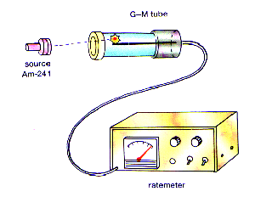
Geiger Counter
Most common to public.
Uses a gas filled tube with a central wire at high voltage to collect the ionization produced by radiation.
Can detect alpha, beta and gamma rays.
Used for demonstrations & rough estimations.

Slide 165
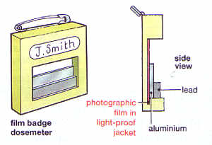
Photographic Film
Radioactivity will darken photographic film.
This effect is used to measure how much radiation has struck the film.

Slide 166
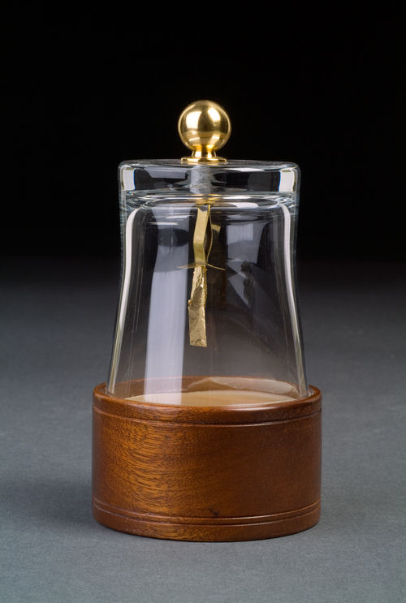
The Gold Leaf Electroscope
When an electroscope is charged, the gold leaf sticks out, because the charges on the gold repel the charges on the metal stalk.
Dry air is normally a good insulator.
When a radioactive source comes near, the air is ionized, and starts to conduct electricity. The electroscope discharges and the gold leaf falls.

Slide 167
The Spark Counter
works best with alpha particles.
uses the ionizing effect of radioactivity.
consists of metal gauze with a wire running underneath known as Spark discharge apparatus.
When a radioactive source is brought near, the air between the gauze and the wire is ionized, and sparks jump where particles pass.

Slide 168
The Cloud Chamber
The chamber contains a supersaturated vapor (e.g. methylated spirits), which condenses into droplets when disturbed and ionized by the passage of a particle.
There are two types of cloud chambers:
the "expansion" type & the "diffusion" type.

Slide 169
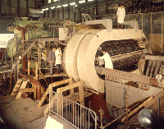
The Bubble Chamber
A similar idea to a cloud chamber.
The bubble chamber similarly reveals the tracks of subatomic particles, but as trails of bubbles in a superheated liquid, usually liquid hydrogen.

Slide 170
Modern Detectors
Scintillation Detectors
work by the radiation striking a suitable material (such as Sodium Iodide), and producing a tiny flash of light.
electronic photomultiplier tubes were matched with scintillators to convert the weak light flashes into usable electric pulses that could be counted electronically.

Slide 171
Modern Detectors…
Solid-State Detectors
the most up-to-date instruments.
used for accurate measurements of radiation energy.
have applications in environmental radiation and trace element measurements.

Slide 172
